Slide 1
Unveiling the optimal driving pattern and operation strategy for cab-drivers in post-2013 Chicago area
Project AHDA
Alice Chung, Huanye Liu, Dongping Zhang, Ningyin Xu

Slide 2
Research Question
Are there any differences in driving patterns between high-income drivers and ordinary-income drivers?

Slide 3
Data - Chicago Taxi Trips Dataset
Source: Chicago Open Data Portal;
Size: 42.76 GBs;
Number of obs: 108,521,750 unique taxi trips;
Time range: 01-01-2013 to 04-01-2017;
Anomalies:
Obs. with no actual driving miles
Obs. with no spatial coordinates
17.29% -- 2013
14.59% -- 2014
15.43% -- 2015
13.87% -- 2016

Slide 4
Major Tasks
Classify and label all taxi drivers to high-income and ordinary-income
Quantify driving pattern
Compare and contrast

Slide 5
Task 1: Classify Drivers
Classification by average annual income
Plot the distribution
Classify by two categories:
1SD+: Top drivers
[-2SD, 1SD]: Ordinary drivers
Initial Test:
Do high income drivers have larger amount of taxi trips?
If this is the case, are they more hard-working? Or more efficient?
How long does it take, on average, to pick up a passenger between high and low income drivers?

Slide 6
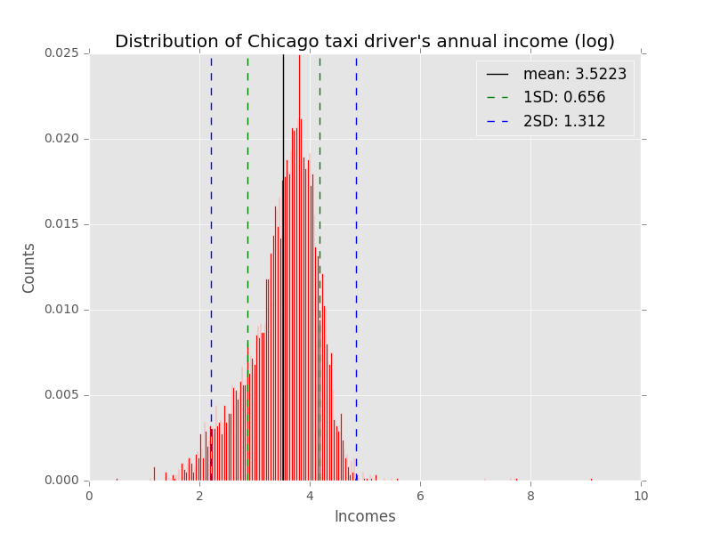
Task 1: Classify Drivers

Slide 7
Task 2: Quantify driving pattern
Analyzing all trips by three conditions:
Analyzing all trips by two statistics
Region
Time
Days
Angularity Ratios:
Ratio of real path length over shortest path length (RRSL)
Ratio of real path travel time over shortest path travel time (RRST)

Slide 8
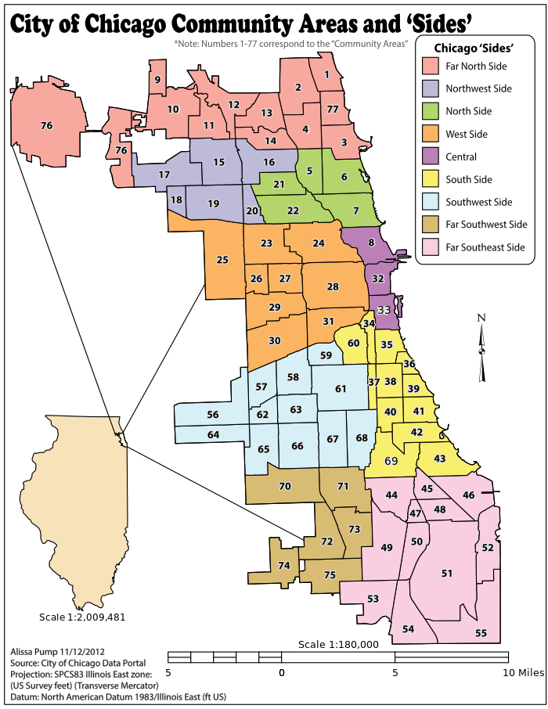
Condition 1: Region
A total of 9 regions:
North:
Far North Side
Northwest Side
North Side
West:
West Side
East:
East
South
Southwest Side
South Side
Far Southwest Side
Far Southeast Side
The work of the Social Science Research Committee at UChicago, officially recognized by the City of Chicago
Notes:
9regions; 77 communities (Ohare 76, Midway 56) ; 881 census tracts

Slide 9
Condition 2: Time
Group 24 hours into 8 temporal units by 3-hour interval
6-9, 9-12, 12-15, 15-18, 18-21, 21-0, 0-3, 3-6

Slide 10
Condition 3: Days
Considering trips based on:
Weekdays
Weekends
Holidays

Slide 11
Angularity Ratio: RRSL
Definition: relative distance (miles driver actually drive) divided by absolute distance (miles between two coordinates)
Interpretation: how many extra miles would a driver take per absolute miles on the map

Slide 12
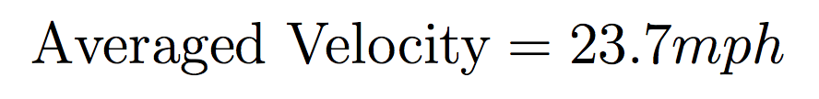
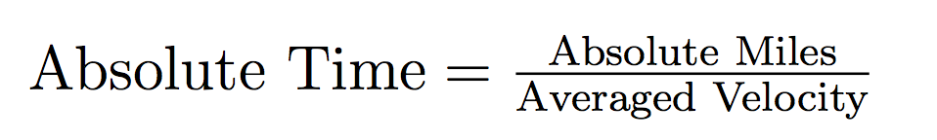
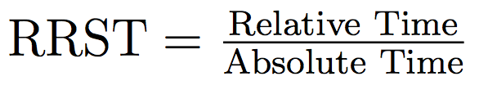
Angularity Ratio: RRST
Interpretation: how many more seconds would a trip take considering the actual route that driver choose to drive
Notes:
python3 driver_divide_hist.py --jobconf mapreduce.job.reduces=1 CSTaxiTrips.csv
try:
total = float(rlist[14])
except:
total = 0

Slide 13
Perspective 1: Pickups and Dropoffs
Pickups and Dropoffs:
Hardworking (Do more trips per day)?
Efficient (How long does it take to get the next passenger)?
Where do high income drivers usually pickup?
What is the difference between high and low income drivers regarding pickup locations?
Why Pickups?
Dropoff locations are completely random once a passenger got picked up.
What is the probability that passenger would go based on his/her pickup location.

Slide 14
Perspective 2: Flow Analysis
Flow analysis:
Difference in route choice: RRSL and RRST

Slide 15
Perspective 3: Money/Fare Analysis
Money Analysis
More total fare for every trip?
More total fare for some trips in some specific regions?
Conditions:
1. Regions
2. Time
3. Days
Looking at tips:
Do high income drivers usually receive more tips because they provide better service to the customers?
Do they tend to visit those low-income neighborhood (decided by hardship index) who work for tips?

Slide 16
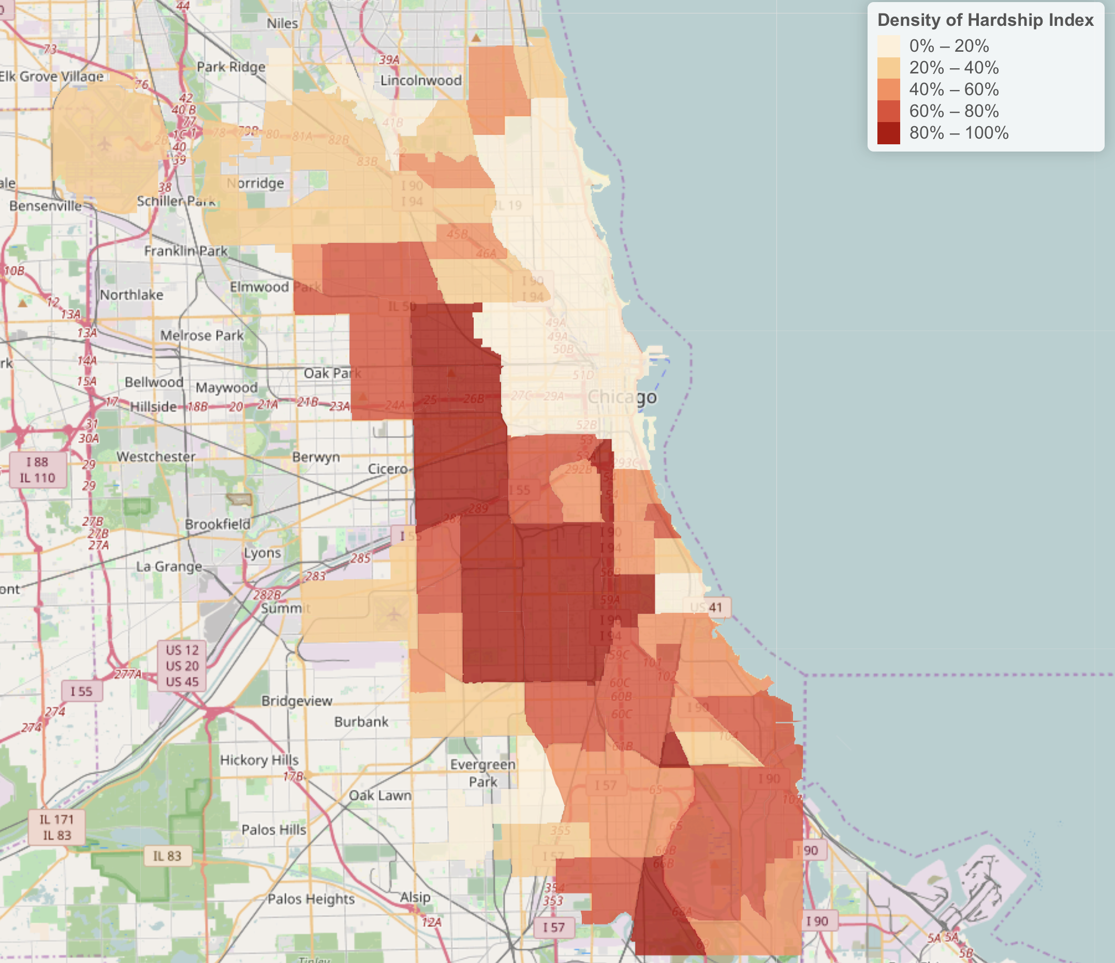
Hardship Index

Slide 17
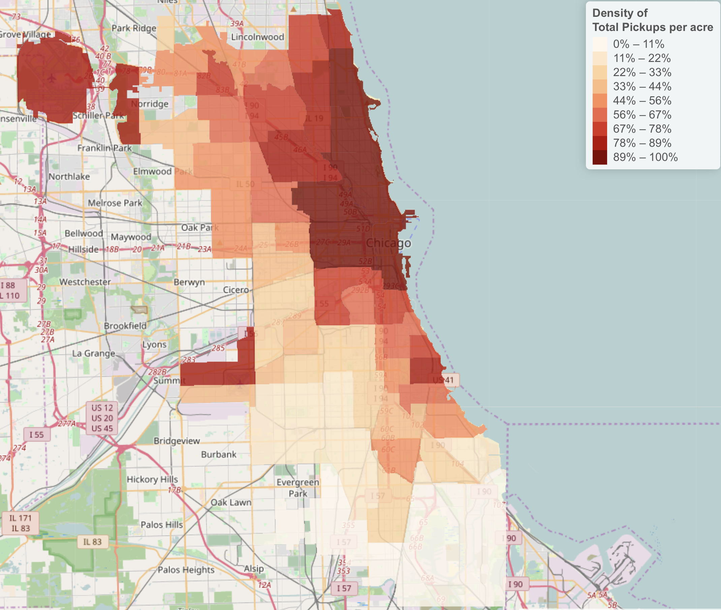
Pickup Density Plot

Slide 18
Sample Flow Analysis Result 1
Year | Origin | Destination | High - Low
2013 | Central | Central | -0.430980
2014 | Central | Central | -0.272855
2015 | Central | Central | -0.153554
2016 | Central | Central | -0.959895

Slide 19
Sample Flow Analysis Result 1
Analysis:
For all trips in 4 years
Pickup location is Central
Dropoff Location is Central
High-income drivers have lower RRSL consistently and -0.45 on average
Explanation: on average, high-income drivers drive 0.45 miles less per absolute mile than low-income drivers
Interpretation: High-income drivers are more familiar with city road condition and all possible “shortcuts”?

Slide 20
Sample Flow Analysis Result 2
Year | Origin | Destination | High - Low
2013 | Central | Southwest Side | -0.382509
2014 | Central | Southwest Side | -1.025993
2015 | Central | Southwest Side | -0.966671
2016 | Central | Southwest Side | -1.728800

Slide 21
Sample Flow Analysis Result 2
Explanation:
on average, high-income drivers drive -1.025 miles less per absolute mile than low-income drivers
Interpretation:
South West Side contains Midway International Airport
Drivers are familiar with airport trips
Less relative miles / absolute miles

Slide 22
Sample Flow Analysis Result 3
Year | Origin | Destination | High - Low
2013 | North Side | Central | 0.182209
2014 | North Side | Central | 0.183870
2015 | North Side | Central | 0.272746
2016 | North Side | Central | 0.724354

Slide 23
Hardship Index

Slide 24
Sample Flow Analysis Result 3
Explanation:
on average, high-income drivers drive 0.34 miles more per absolute mile than low-income drivers
Interpretation:
Drivers know that the North Side has the higher density of wealthy households
So they would try to rip them off
Need to look at other census variables

Slide 25
Thank you!

